Slide 1
SKU Flow & Range Management
Dynamic Range size (# of SKUs)
Incoming SKU
Outgoing SKU
NPI
End of life
Not performing
Not available
Category / Price Band Range
Best Performing
Promotions
Notes:
Flow
Why PB:
When the client go to store he knows how much he want to spend
The PB (after category) Represent the best way to utilize store unique location
Optimize traffic

Slide 2
NPI

Slide 3
Why Change the Current Practice?
We do not have a crystal ball for the future sales of new products.
In many cases, new products are turned to tail / obsolescence immediately.
For example: We examined 200 new products that were ranged in one months. In the following 6 months, 40% of them contributed to 1% of the 200 SKUs total sales.
Therefore, we believe that improving this process can reduce the contribution of new products to the tail significantly.

Slide 4
NPI Definitions
Replacement:
A product that was not sold in Croma's stores and
The potential costumer cannot differentiate between it and the older product it replaces.
New Product:
a product that was not sold in Croma's stores, and
Is not a replacement.

Slide 5
Replacement Process
Replacement: (we have good data to count on)
The ranging is done with relation to the prior product.

Slide 6
NPI Processes
New Product: (we do not have sufficient data to count on)
Type 1 – “Hero” Product – Wide ranging, according to C/PB performance with average buffer.
Type 2 – Nation wide promotion – Wide ranging, according to C/PB performance with conservative buffer
Type 3 – Regular
Create a representative pilot that will deliver a reliable and fast feedback loop regarding the performance of the product.
Use the pilot results in determining in which stores to range the product, and which other product (if any) needed to be deranged from each store in order to accommodate the new product.

Slide 7
Pilot Design
How should we design the pilot?
The pilot should be designed in a way that will provide the best (reliable, relevant and fast) feedback loop, in a way that will enable us to decide the best ranging of the new product.

Slide 8
New Segmentation - Price Band
Assumption – the Category, class and price band together, represents the traffic of the type of clients that is looking for this type of products
A client that is looking for the newest smart phone is the same for all stores.
A client that is looking for an LCD, between 32 and 37 inch, and want to spend about 10,000INR, is the same for all stores.
Conclusion:
We do not need to divide the stores into groups.
We can make a pilot for a new product from specific C/PB in few stores, and understand from the result, what is the potential of this product in all other stores that play in this C/P`B
The best (reliable, relevant and fast) pilot should be done in stores that the sales of the C/PB, are highest and fastest.

Slide 9
Initial Framework Design
Procedure | Details | Frequency
Define C/PB & assign C/PB for each SKU | Divide the products to the following groups: Category (already exist) Class (might requires a change) Price Band (Premium, High, Medium, Low) | Once & assignment for each new SKU
Define for each C/PB the life span of the product | The pilot length will be 5% - 15% of the life span | Yearly
Define default conservative buffer for each C/PB |  | Quarterly
For each C/PB, rank the stores according to sales (Q) in the last quarter. | The Top 4-7 stores are the pilot stores for this C/PB | Quarterly
Define average monthly sales (Q) for active SKUs in each Store/C/PB | Will be used to define a benchmark for the pilot results | Monthly

Slide 10
Defining the Price Band
The price of the most expensive product in the C/PB
Premium
Premium
Premium
Premium
60%
High
High
High
30%
Med
Med
10%
The price of the cheapest product in the C/PB
Low

Slide 11
Defining the Price Band
Example:
Category: Mobile Computing
Class: Notebooks
The price of the most expensive product in the C/PB
136,095
Premium
Premium
Premium
Premium
60%
106,560
High
High
High
30%
77,025
Med
Med
10%
47,490
The price of the cheapest product in the C/PB
Low
17,955

Slide 12
Defining the Price Band
136,095
Premium
Premium
Premium
High
Premium
Med
Low
Premium
106,560
High
High
High
77,025
Med
Med
47,490
Low
17,955

Slide 13
Defining the Price Band

Slide 14
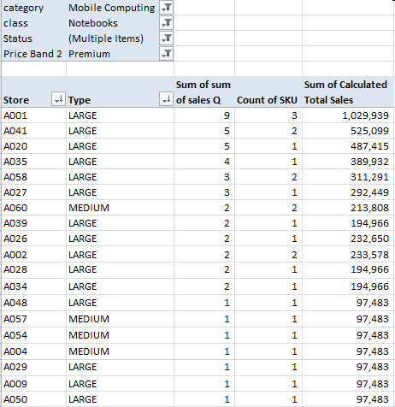
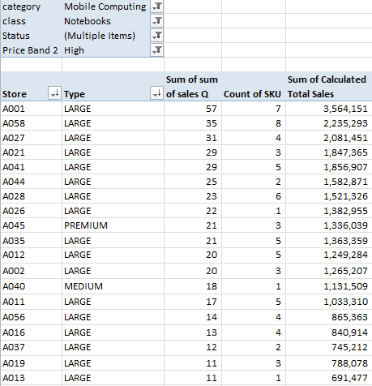
Stores Sorting according to Sales of C/PB Mobile Computing, Notebooks

Slide 15
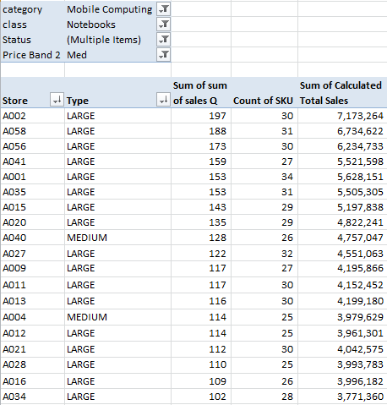
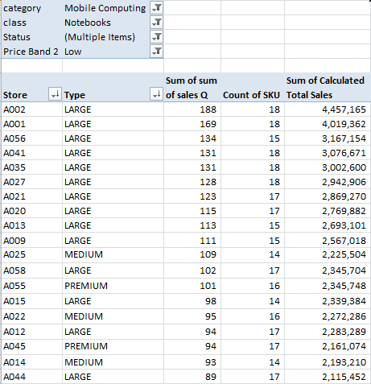
Stores Sorting according to Sales of C/PB Mobile Computing, Notebooks

Slide 16
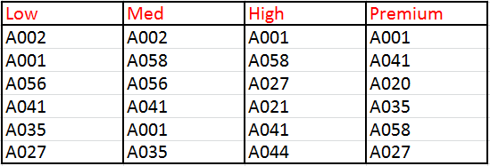
Identifying Best Stores in each C/PB
The Top selling stores in each C/PB will be the best pilot group for a new SKU in that C/PB.

Slide 17
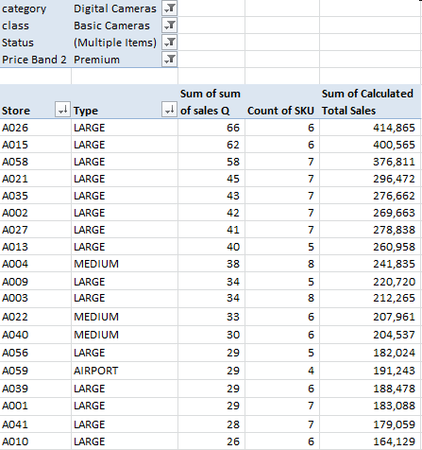
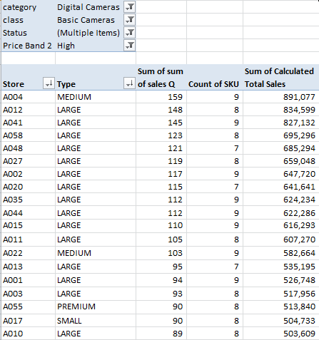
Stores Sorting according to Sales of C/PB Digital Cameras, Basic Cameras

Slide 18

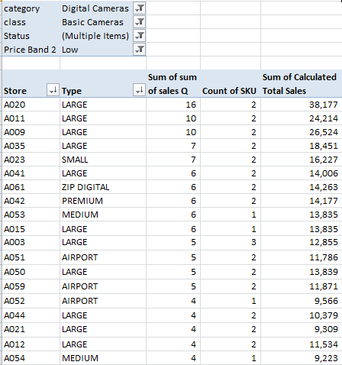
Stores Sorting according to Sales of C/PB Digital Cameras, Basic Cameras

Slide 19
NPI Processes
Replacement: (we have good data to count on)
The ranging is done with relation to the prior product.
New Product: (we do not have sufficient data to count on)
Create a representative pilot that will deliver a reliable and fast feedback loop regarding the performance of the product.
Use the pilot results in determining in which stores to range the product, and which other product (if any) needed to be deranged from each store in order to accommodate the new product.

Slide 20
After the Pilot…
Did the SKU passed the pilot?
In which stores to range the SKU?
What to derange from each store to make place for the new SKU?

Slide 21
1. Did the SKU Passed the Pilot?
Once a month, define average monthly sales (Q) for active SKUs in each Store/C/PB
STORE A002 | Category | Class | Price Band | average monthly sales (Q)
SKU1 | Mobile Computing | Notebooks | Low | 10
SKU2 | Mobile Computing | Notebooks | Low | 8
SKU3 | Mobile Computing | Notebooks | Low | 12
SKU4 | Mobile Computing | Notebooks | Low | 6
AVERAGE |  |  |  | 9

Slide 22
1. Did the SKU Passed the Pilot?
Pilot Stores | Category | Class | Price Band | average monthly sales (Q) | Sales of the pilot SKU (10 days) | Sales of the pilot SKU Normalized to a month | Is the pilot SKU sales are above the average?
A002 | Mobile Computing | Notebooks | Low | 9 | 4 | 4*30/Pilot time = 4*30/10=12 | Yes
A001 | Mobile Computing | Notebooks | Low | 7 | 2 | 6 | No
A056 | Mobile Computing | Notebooks | Low | 6 | 1 | 3 | No
Thumb rule should be that if the pilot was successful in more than 1/3 of the pilot stores, than we are moving to the next step.
A managerial decision should be taken if the pilot results are not decisive.

Slide 23
2. Where to Range the New SKU?
For each store, we should check if we should range the new SKU or not:
We need to estimate how much this SKU is going to sell in this store.
We assume that using the ratio of quarterly C/PB sales between the pilot stores and the target stores, we can extrapolate the sales of the new SKU from the pilot stores, to the target stores.
For example: Pilot store A sells 100 quarterly and sold 6 of the pilot SKU.
We want to range in a store that sells 50 quarterly – half of the pilot store.
So we assume that the new product can sell 3 in this store.
The decision point is: If this SKU estimated sales are more than the current average in this Store/C/PB than range the SKU.
Notes:
If space available – maybe if grow average

Slide 24
2. Where to Range the New SKU?
Pilot Stores | Sales of the pilot SKU | Total Sales of the C/PB in the last quarter | The “Power” of the new SKU in this C/PB
A002 | 12 | 100
A001 | 6 | 50
A056 | 3 | 39
TOTAL in pilot period | 21 | 189
TOTAL in a month | 21*30/pilot period = 63 | 189 | X= 189/63 = 3
Other Stores | Total Sales of the C/PB in the last quarter | Estimated sales of the new SKU in a month | average monthly sales (Q) | Action
A003 | 30 | 30/X = 30/3 = 10 | 8.5 | Range
A016 | 21 | 21/3 = 7 | 7.9 | Do not Range
A062 | 6 | 6/3 = 2 | 1 | Range

Slide 25
3. What to Derange?
Identify if there is a need to derange (gap between range defined and current range)
If there is a gap, range the new SKU
If there is no gap, derange the worst performing SKU
If the difference between the worst performing and the average is less than 20%, involve manual decision.
Example for Store A003: Defined Range = 4
STORE A003 | Category | Class | Price Band | Monthly Sales
SKU1 | Mobile Computing | Notebooks | Low | 11
SKU2 | Mobile Computing | Notebooks | Low | 4
SKU3 | Mobile Computing | Notebooks | Low | 6
SKU4 | Mobile Computing | Notebooks | Low | 13
AVERAGE |  |  |  | 8.5
Pilot SKU | Mobile Computing | Notebooks | Low | Estimated = 10

Slide 26
WS

Slide 27
Initial Framework Design
Procedure | Details | Frequency
Define C/PB & assign C/PB for each SKU | Divide the products to the following groups: Category (already exist) Class (might requires a change) Price Band (Premium, High, Medium, Low) | Once & assignment for each new SKU
Define for each C/PB the life span of the product | The pilot length will be 5% - 15% of the life span | Yearly
Define default conservative buffer for each C/PB |  | Quarterly
For each C/PB, rank the stores according to sales (Q) in the last quarter. | The Top 4-7 stores are the pilot stores for this C/PB | Quarterly
Define average monthly sales (Q) for active SKUs in each Store/C/PB | Will be used to define a benchmark for the pilot results | Monthly

Slide 28
Decide on Segmentation Design
Four options:
Category / Current Class / PB (Max 4)
Category / Revised Class / PB (4)
Category / Parallel IRL Class / PB (4)
Category / PB (~10)

Slide 29

NPI RAID Description
Buyer will create the primary NPI proposal based on the Vendors offering and category knowledge
SM will recommend whatever go for pilot or direct ranging. If we go direct what is the ranging and initial buffer
Business Manger will sigh off
IRL OP and Marketing sign of
Marketing and Operation / logistic
NPI committee will be the final decision maker
29
Recommend
R
Agree
A
Input
I
Decide
D

Slide 30
RAID Description
Buyers will communicate to al relevant stake holders
Buyers will execute the vendor order and DC buffer and replenishment
Store Merchandising will execute the stores ranging,& buffers
Store Merchandising will measure the NPI performance
Store Merchandising will analyze NPI performance and approve additional ranging in case of Pilot introduction
Communicate
C
Execute
E
Measure
M
Analyze
A

